Slide 1

Note: The data and information in this document is reflective of a hypothetical situation and client. This document is to be used for KPMG Virtual Internship purposes only.
Sprocket Central Pty Ltd
Data analytics approach
[Division Name] - [Engagement Manager], [Senior Consultant], [Junior Consultant]

Slide 2
Note: The data and information in this document is reflective of a hypothetical situation and client. This document is to be used for KPMG Virtual Internship purposes only.
Agenda
Introduction
Data Exploration
Model Development
Interpretation

Slide 3
Note: The data and information in this document is reflective of a hypothetical situation and client. This document is to be used for KPMG Virtual Internship purposes only.
Introduction
Identify and Recommending High value customers
Outline of Problem
Sprocket Central is a company that specializes in high quality bikes and accessories.
The marketing team is looking to boost sales.
To target 1000 new customers that will bring the highest value to the business.
Approach for data analysis
Bike related purchases for the last three years based on gender.
Top industries contributing the maximum profits and bike related sales.
Wealth segment by age factor.
Number of cars owned in each state.
Customer Classification.

Slide 4
Note: The data and information in this document is reflective of a hypothetical situation and client. This document is to be used for KPMG Virtual Internship purposes only.
Data Exploration
Data Quality Assessment
Key issues dealt with for the data quality issues:
 | Accuracy | Completeness | Consistency | Currency | Relevancy | Validity
Customer Demographic | DOB: Inaccurate Age: Missing | Job Title: Blanks Customer ID: Incomplete | Gender: Inconsistent | Deceased Customer: Filtered out | Default Column: Delete
Customer Address |  | Customer ID: Incomplete | States: Inconsistent
Transactions | Profit: Missing | Customer ID: Incomplete Online orders: Blanks Brands: Blanks |  |  | Cancelled Status Order: Filtered out | List Price: Format Product Sold Date: Formant

Slide 5
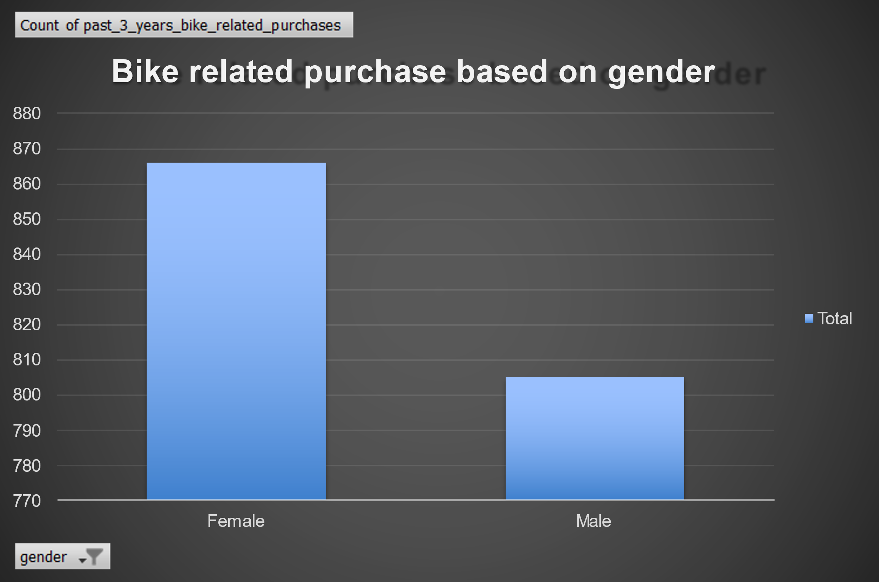
Note: The data and information in this document is reflective of a hypothetical situation and client. This document is to be used for KPMG Virtual Internship purposes only.
Data Exploration
Bike related Purchase Over The last 3 Years Based On Gender
Data shows, on average females have made more bike related purchase over the last 3 years compared to males.
On average, females have had 1% higher bike related purchases compared to men in last 3 years.

Slide 6
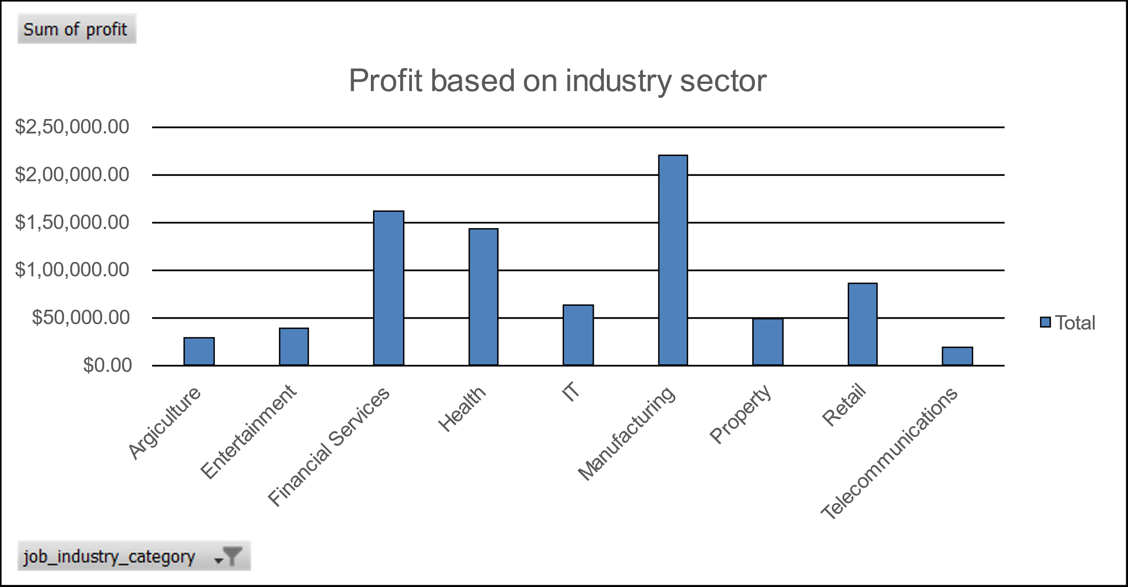
Note: The data and information in this document is reflective of a hypothetical situation and client. This document is to be used for KPMG Virtual Internship purposes only.
Data Exploration
Top Job Industries Contributing to the Maximum Profit & Bike Related Purchases
The top 3 industry sectors bringing in the highest profit are Manufacturing, Financial services and Health.
These can be obvious as most of these industry sectors are based within the city or on the outskirts of the city therefore consumers prefers bikes for commuting.
Most of the industry sectors have returned less than $64,000 in profits.

Slide 7
Note: The data and information in this document is reflective of a hypothetical situation and client. This document is to be used for KPMG Virtual Internship purposes only.
Data Exploration
Group 1: 20 – 29 Group 2: 30 – 39 Group 3: 40 – 49 Group 4: 50 – 59 Group 5: 60 – 69 Group 6: 70 – 89
Profit of Wealth Segment by Age Cluster
Overall, the Mass customer segmentation makes the highest profit across the different age clusters.
Mass Customer Aged between 40 – 49 are likely to bring more profit for the company compared to other age clusters
This also indicates a trend of buying power, as the buying power increases over time 49 and then see’s a decline in buying power, thus leading to lower profits.

Slide 8
Note: The data and information in this document is reflective of a hypothetical situation and client. This document is to be used for KPMG Virtual Internship purposes only.
Data Exploration
Number of Cars Owned in each state
NSW, QLD & VIC could be potential market opportunities for the company.
NSW, has the highest potential as number of people that own car is less that the number of people who don’t own cars which shows that there is an opportunity to find value customers there.

Slide 9
Note: The data and information in this document is reflective of a hypothetical situation and client. This document is to be used for KPMG Virtual Internship purposes only.
Model Development
Customer Classification – Targeting High Value Customers
These are the high value customers that should be targeted from the new list:
1. Most of the high value customers will be female compared to male.
2. Working in financial services, health and manufacturing industry sector.
3. Aged between 40 – 49
4. Who are currently living in NSW, VIC.

Slide 10
Note: The data and information in this document is reflective of a hypothetical situation and client. This document is to be used for KPMG Virtual Internship purposes only.
Interpretation
Summary Table for High Value Customers
Here is a snapshot of a few customers that will come under high value customer classification
First Name | Bike Related Purchases for the last 3 Years | Age | Job Industry | Wealth Segment | Own Cars | State
Rutledge | 23 | 45 | Financial Services | Mass Customer | No | NSW
Duff | 50 | 49 | Manufacturing | Mass Customer | Yes | NSW
Melba | 38 | 45 | Health | Mass Customer | No | NSW
Winnifred | 83 | 45 | Financial Services | Mass Customer | No | VIC
Mitchell | 58 | 42 | Manufacturing | Mass Customer | No | VIC
Gale | 59 | 44 | Financial Services | Mass Customer | Yes | VIC
Martelle | 52 | 40 | Manufacturing | Mass Customer | No | NSW
Chanda | 15 | 49 | Manufacturing | Mass Customer | Yes | NSW
Esther | 14 | 40 | Financial Services | Mass Customer | No | NSW
Patricia | 34 | 43 | Health | Mass Customer | No | NSW

Slide 11
Note: The data and information in this document is reflective of a hypothetical situation and client. This document is to be used for KPMG Virtual Internship purposes only.
Thank you

